Slide 1
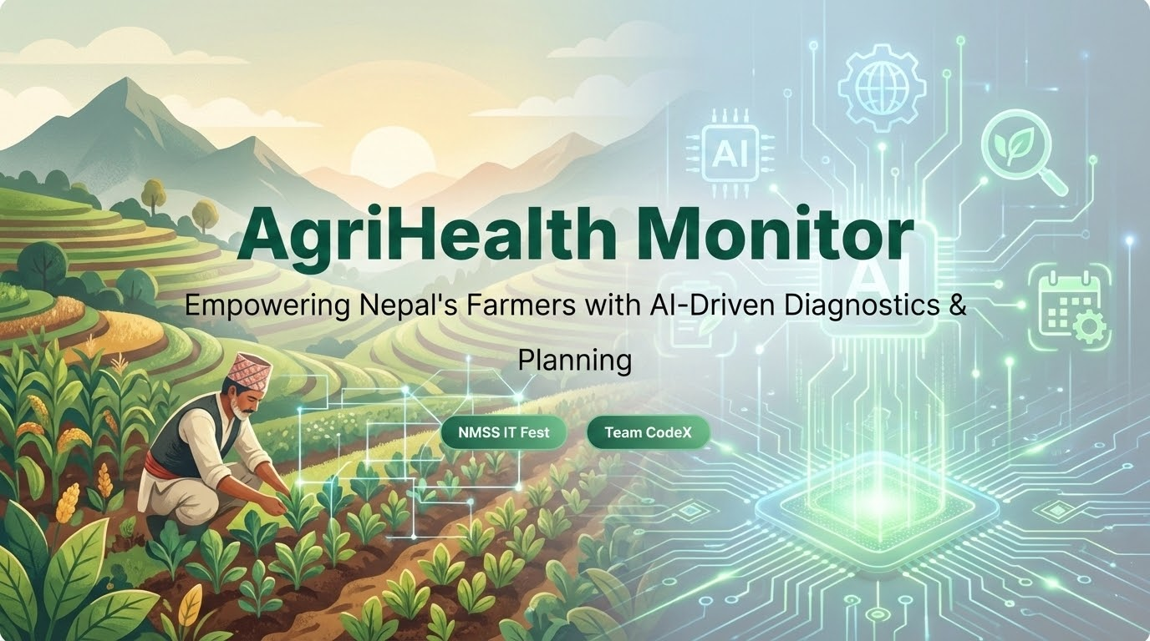

Slide 2
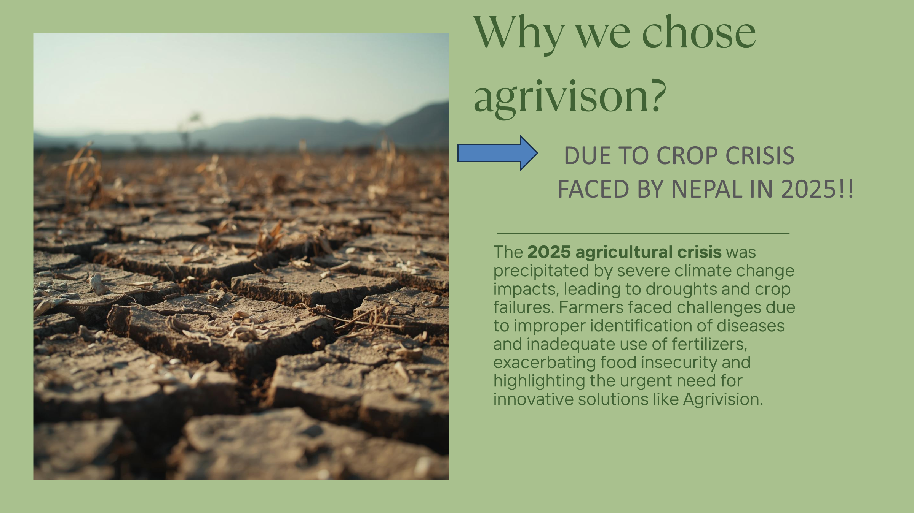
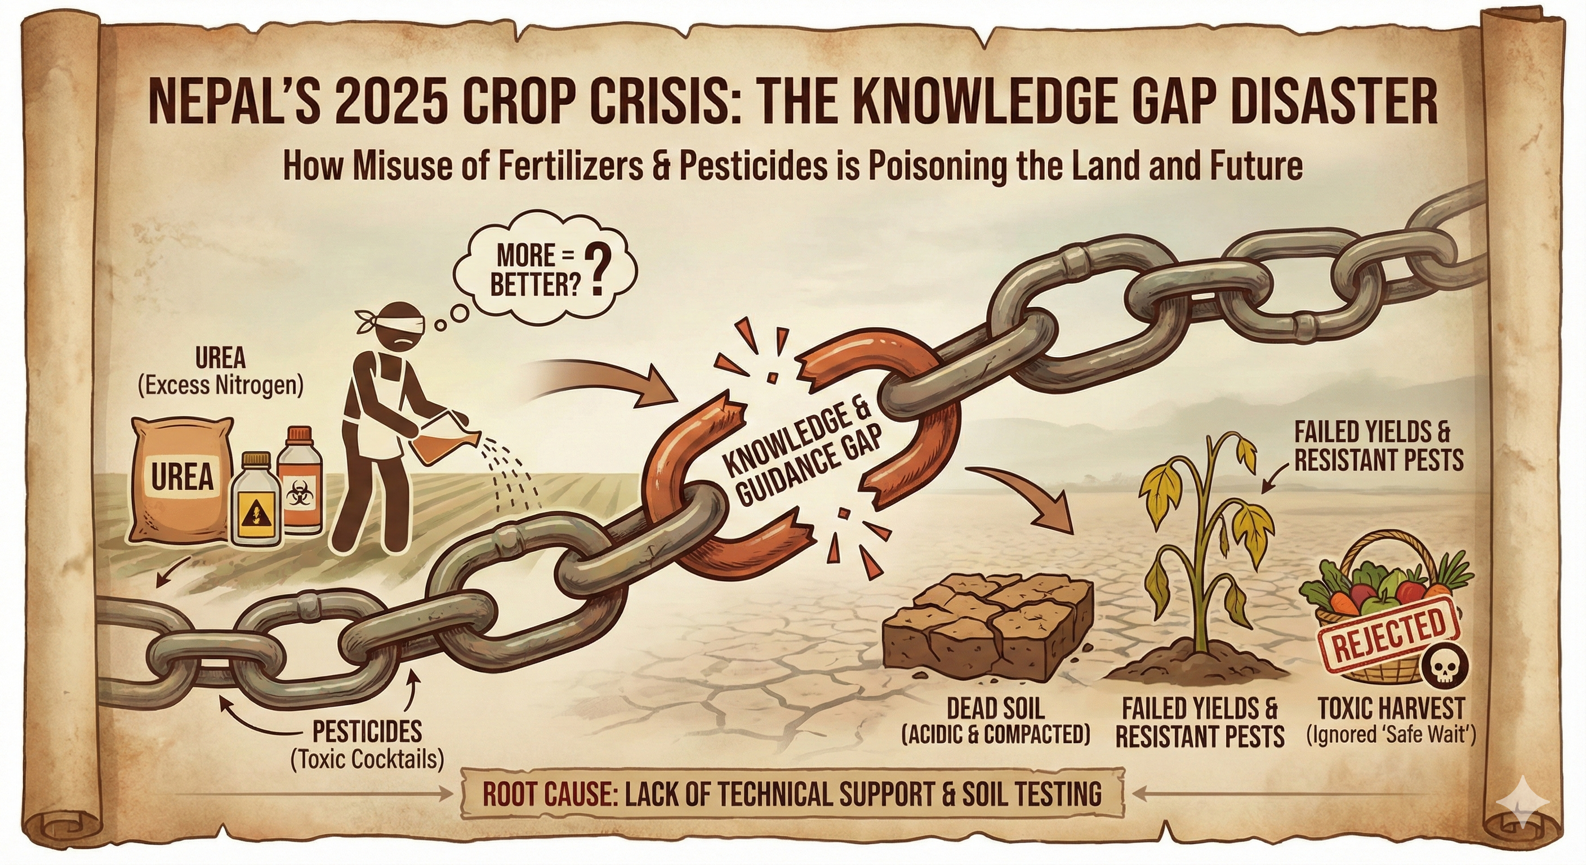

Slide 3

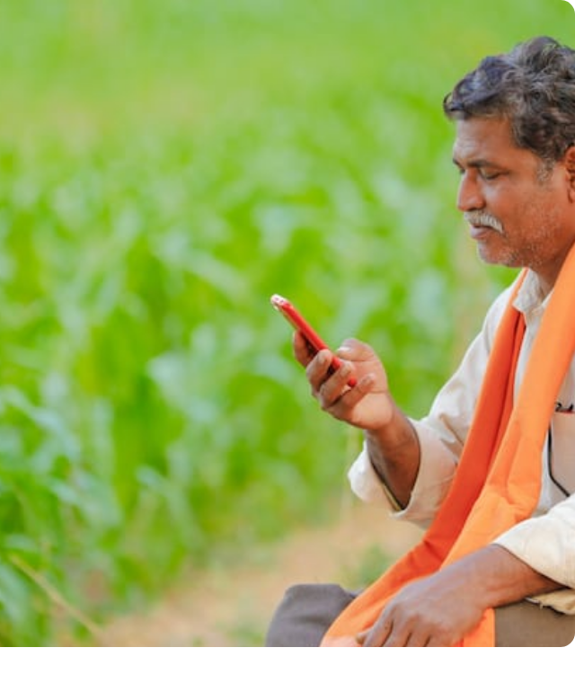
The Challenge
01. Lack of Expertise
Rural farmers struggle to identify plant diseases accurately without access to agricultural experts.
02. Unpredictable Seasons
Climate change has disrupted traditional farming calendars, leading to poor harvest planning.
03. Language Barriers
Most modern tech solutions are in English, making them inaccessible to the local population.

Slide 4

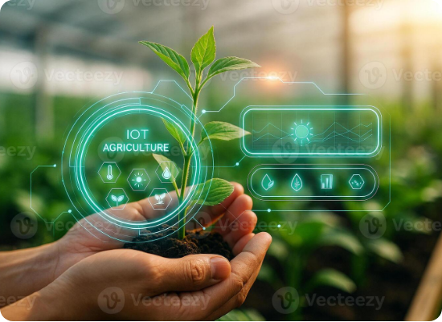
Introducing AgriHealth
Your Pocket Agri-Expert
AgriHealth Monitor is a comprehensive mobile-first application that bridges the gap between traditional farming and modern AI.
•
Instant Disease Diagnosis
•
Localized Crop Calendars
•
Voice-Activated Assistant

Slide 5
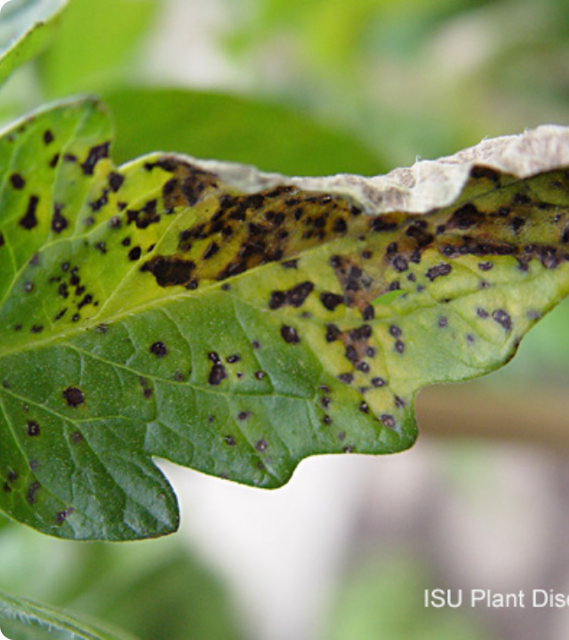
AI Plant Doctor
Gemini Vision Integration
Simply take a photo of a sick plant. Our AI analyzes the visual patterns to detect diseases, pests, or nutrient deficiencies with 95% accuracy.
Actionable Remedies
We don't just name the disease; we provide immediate, organic, and chemical treatment plans in both English and Nepali.

Slide 6
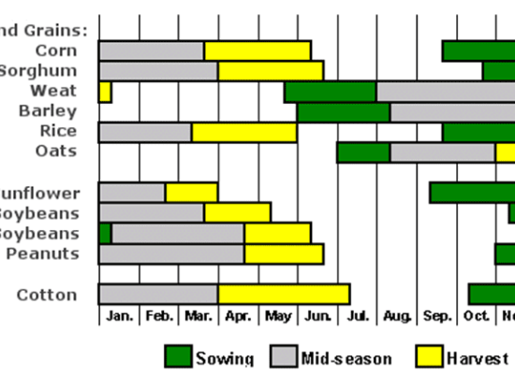
Smart Crop Planner (Kheti-Patro)
Generative Scheduling
Select your crop (Rice, Maize, Wheat) and the AI generates a customized timeline based on Nepal's current weather and season.
Integrated Tasks
The schedule creates a checklist for:
•
Preparation & Sowing
•
Irrigation & Fertilization
•
Harvesting

Slide 7






Voice-First Accessibility
Speak in Nepali
Gemini Intelligence
Text-to-Speech
Farmers can ask questions verbally. We use Web Speech API to transcribe Nepali voice input directly.
The AI understands context about soil, weather, and farming techniques to give accurate answers.
The answer is read aloud, making critical information accessible to illiterate users.

Slide 8
Impact by the Numbers
66%
4G
of Nepal engaged in Agriculture
Rapidly expanding mobile coverage
With rising smartphone penetration in rural Nepal, AgriHealth Monitor is positioned to become the essential digital tool for over 15 million potential users.

Slide 9

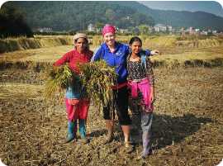
Thank You!
Questions?

Slide 10
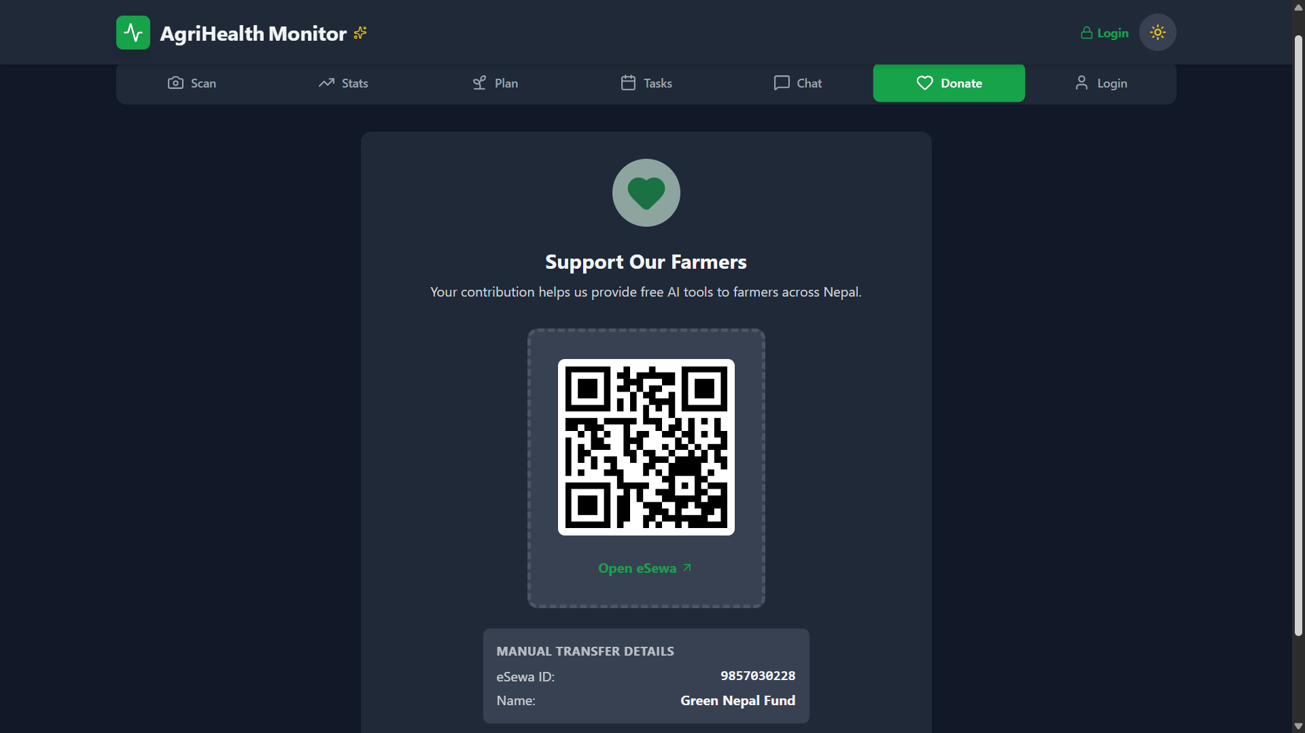
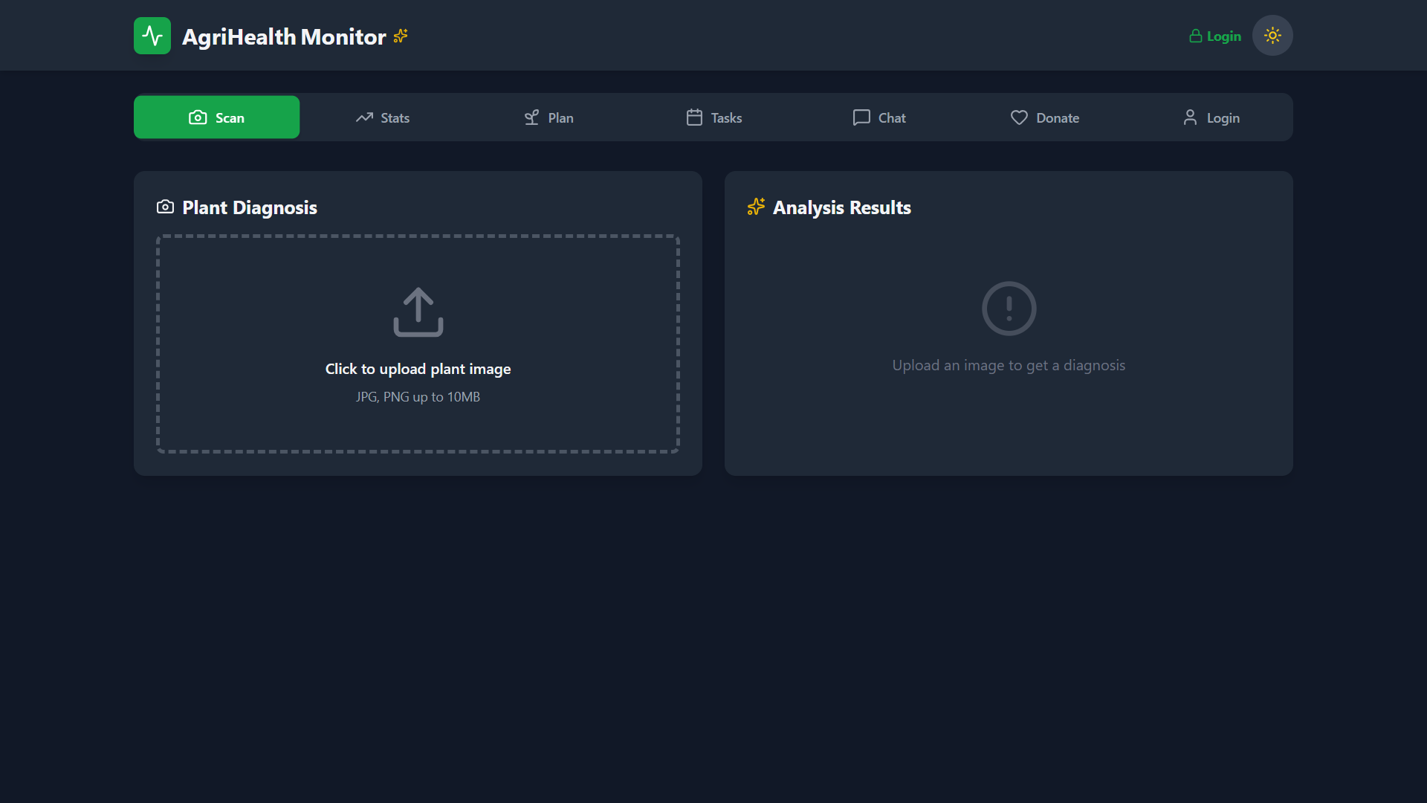
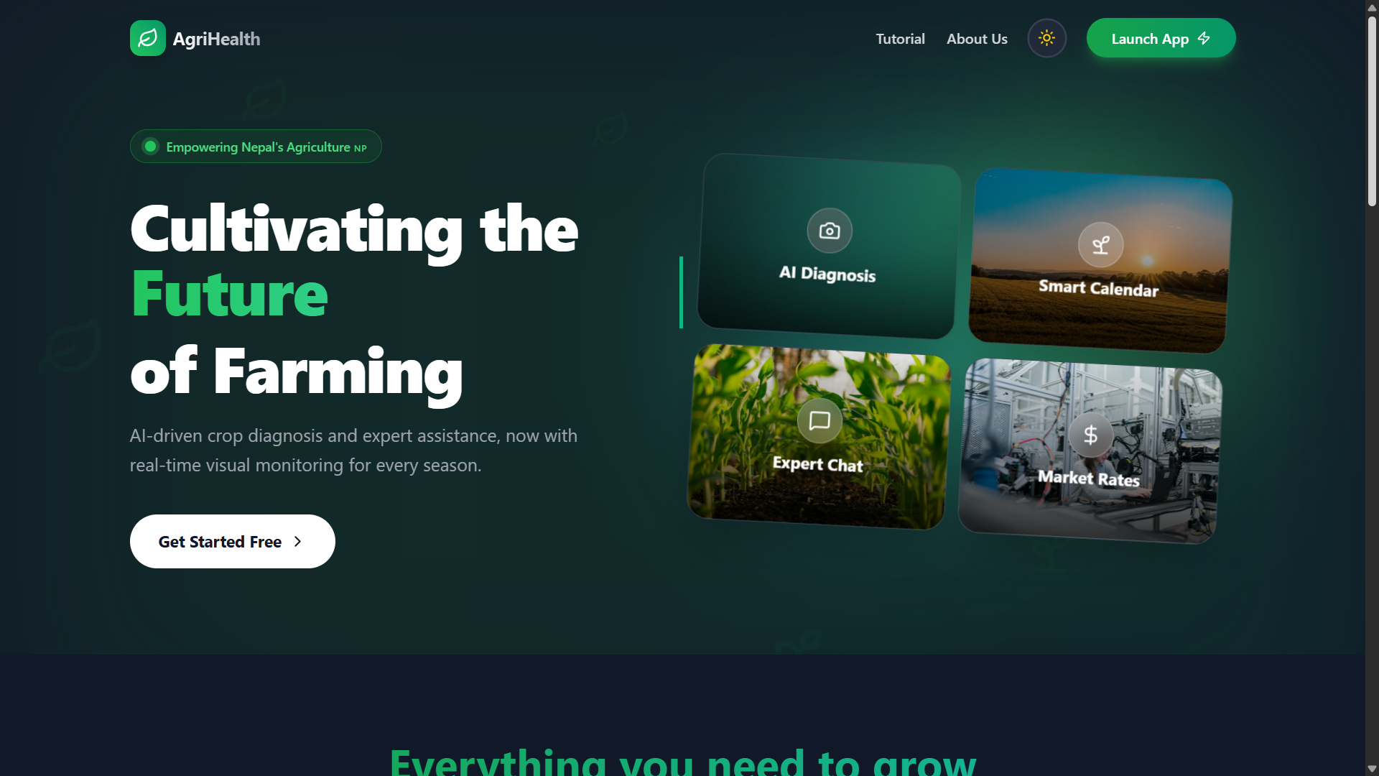
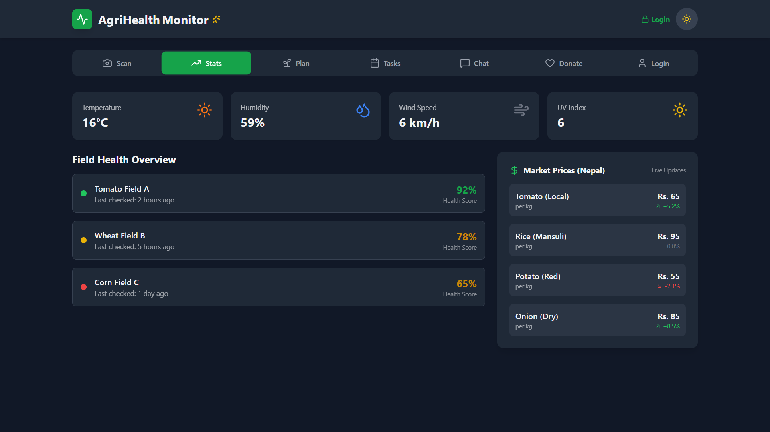
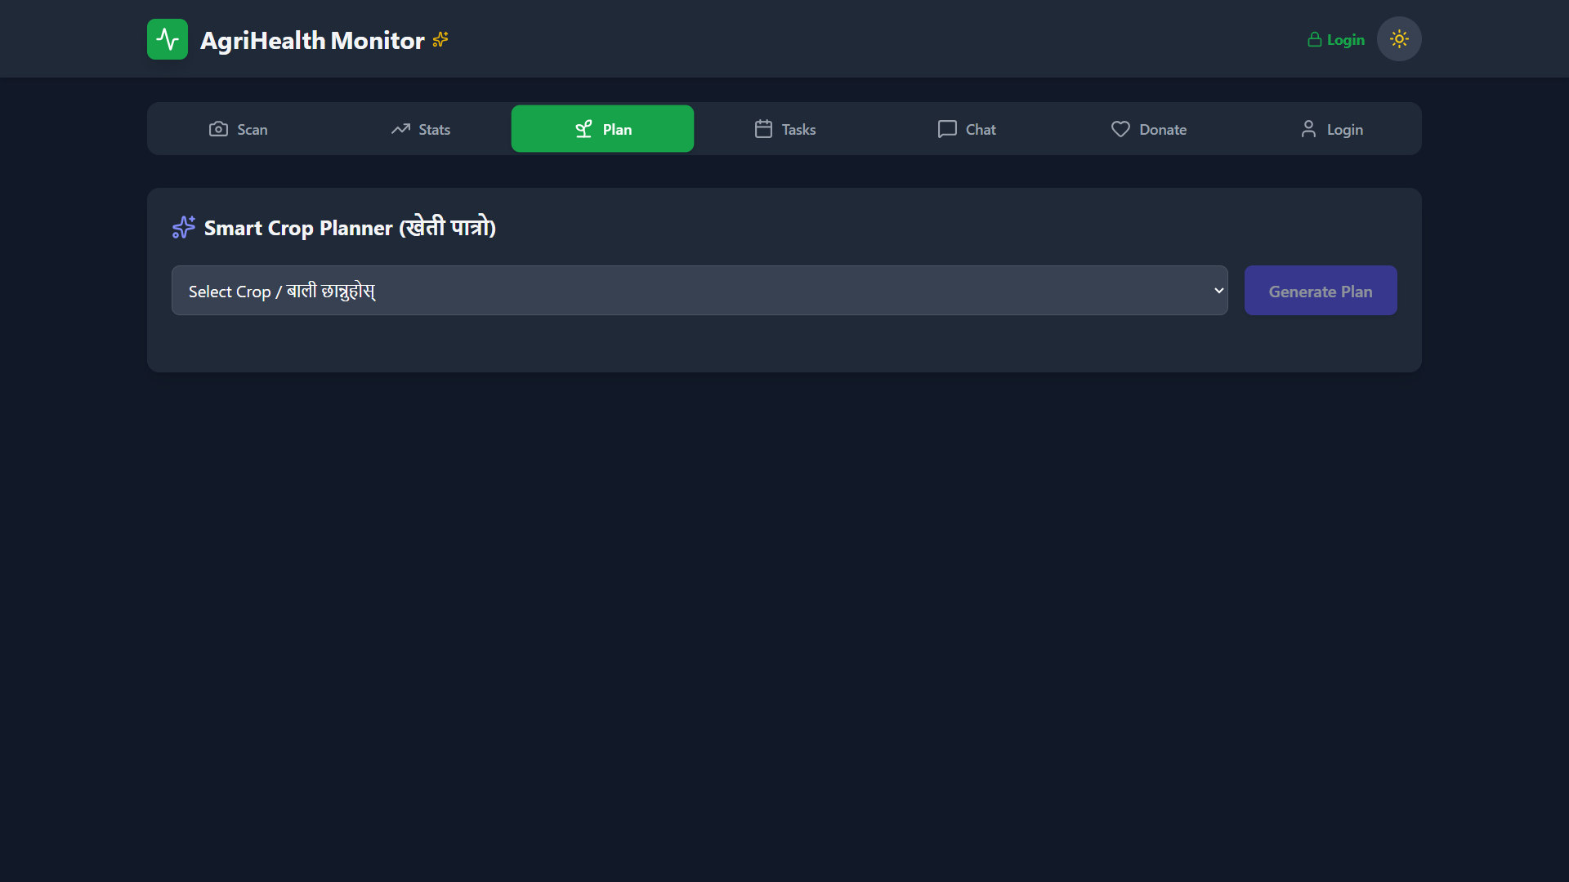
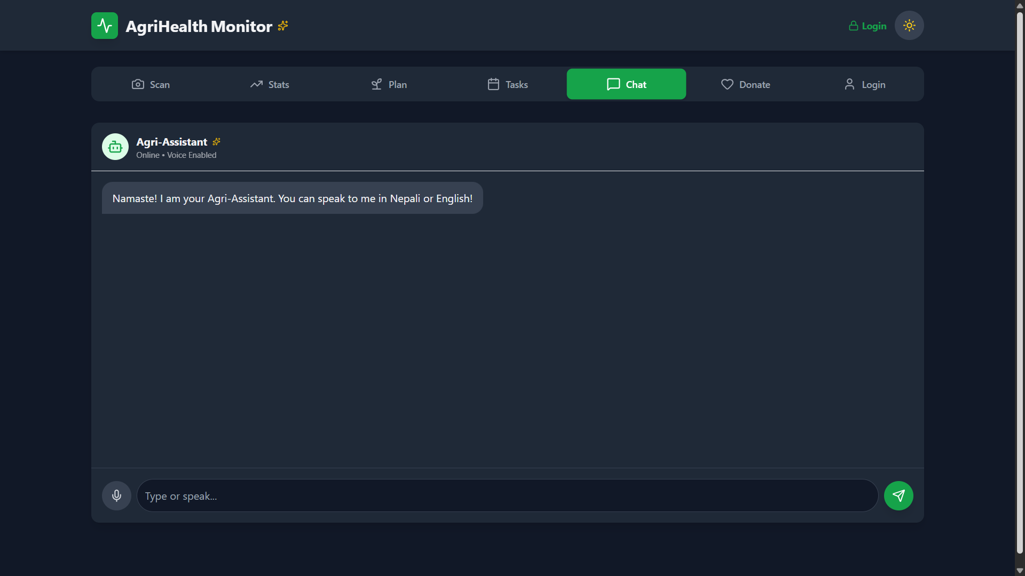
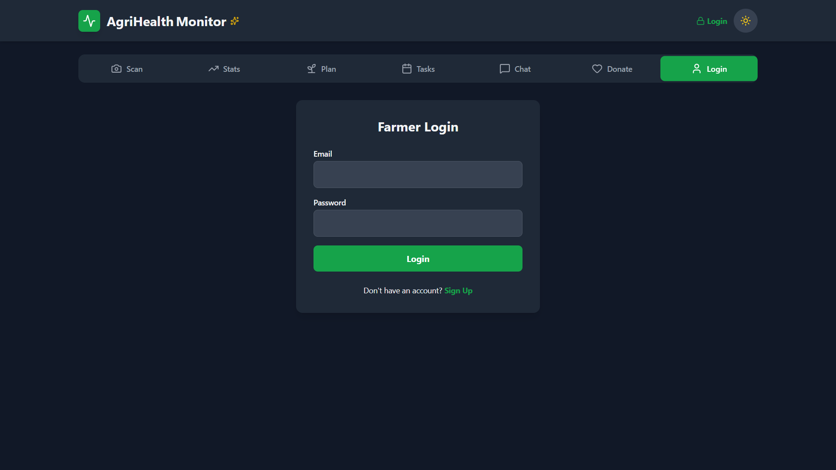
User Interface of AgriVision- Smart Crop Monitoring System

